Slide 1
AUTOMATIC DETECTION OF BIKE-RIDERS WITHOUT HELMET USING SURVEILLANCE VIDEOS IN REAL-TIME
Authored By :
Kunal Dahiya, Dinesh Singh, C. Krishna Mohan
Presentation By:
PRASAN CHANDAK

Slide 2
INTRODUCTION
Challenges to be Addressed:
Real-time Implementation: Processing significant amount of information in a time constraint manner is a challenging task.
Occlusion: In real life scenarios, the dynamic objects usually occlude each other due to which object of interest may only be partially visible.
Direction of Motion: 3-dimensional objects in general have different appearance from different angles.
Temporal Changes in Conditions: Over time, there are many changes in environment conditions such as illumination, shadows, etc.
Quality of Video Feed: Generally, CCTV cameras capture low resolution video. Also, conditions such as low light, bad weather complicate it further.

Slide 3
PROPOSED WORK
The proposed approach works in two phases:
In the first phase, the bike-rider in the video frame is detected.
In the second phase, the head of the bike-rider is located and it is detected whether the rider is using a helmet or not.
In order to proceed further, we apply background subtraction on gray-scale frames, with an intention to distinguish between moving and static objects.

Slide 4
Background Modelling
Background subtraction method retrieves only moving objects and ignores non-useful details such as static objects.
Moving objects which are not of interest such as humans, cars etc. are filtered based on their area.
This method assumes that for a fixed camera, area of closing boundary of bikes is well differentiated from objects with very large area such as bus or very small area such as noise.
The objective behind this is to only consider objects which are more likely to fall in bike riders category. It helps in reducing the complexity of further steps.

Slide 5
A. Phase-I: Detecting Bike-riders
This phase involves two steps : feature extraction and classification:
Feature Extraction : HOG, SIFT and LBP are proven to be efficient for object detection.
Histogram of Oriented Gradients : These descriptors capture local shapes through gradients.
Scale Invariant Feature Transform : This approach tries to capture key-points in the image.
Local Binary Patterns : These features capture texture information in the frame.
Classification: Classify as ‘bike-riders’ vs ‘other’ objects. Requires a binary classifier (here, SVM is used). Different kernels such as linear, sigmoid (MLP), radial basis function (RBF) are used to arrive at best hyper-plane.

Slide 6
B. Phase-II: Detection of Bike-riders Without Helmet
Feature Extraction: Identified region around head of bike-rider is used to determine if bike-rider is using the helmet or not using HOG, SIFT and LBP.
Classification: Two classes - Bike-rider not using helmet (Positive Result) and Biker using helmet (Negative Result).
The support vector machine (SVM) is used to classify using extracted features from previous step. To analyse the classification results and identify the best solution, different combination of features and kernels are used.

Slide 7
C. Consolidation of Results
From earlier phases, local results are obtained i.e. whether bike rider is using helmet or not, in a frame.
However, till now the correlation between continuous frames is neglected.
So, in order to reduce false alarms, we consolidate local results.
A combination of independent local results from frames is used for final global decision i.e. biker is using or not using helmet.

Slide 8
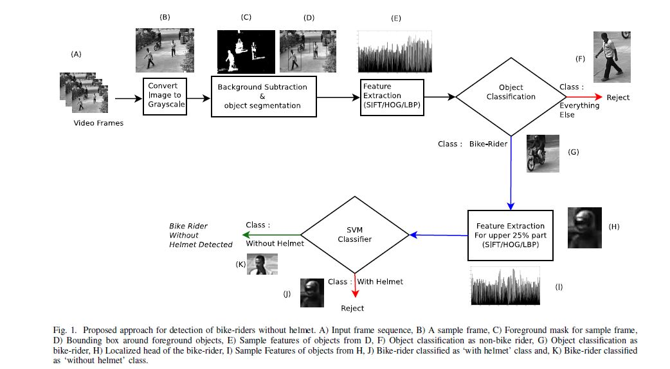
Proposed Approach

Slide 9
RESULTS
Computational Complexity
To test the performance, a surveillance video of around one hour at 30 fps i.e. 107500 frames was used.
The proposed framework processed the full data in 1245.52 secs i.e. 11.58 ms per frame.
However, frame generation time is 33.33 ms, so the proposed framework is able to process and return desired results in real-time.

Slide 10
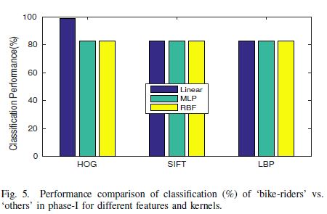
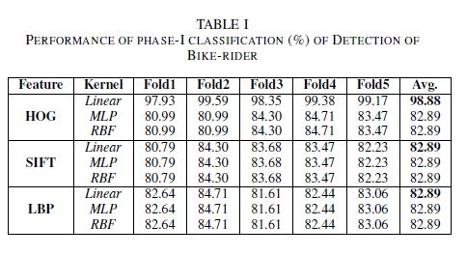
Phase-I
Table. I presents results for bike-rider detection using different features viz. HOG, SIFT, LBP and kernels viz. linear, sigmoid (MLP), radial basis function (RBF).
The experimental results in Table I show that average performance of classification using SIFT and LBP is almost similar.
HOG with linear kernel performs better than all other combinations, because feature vector for this representation is sparse in nature which is a suitable for linear kernel.

Slide 11
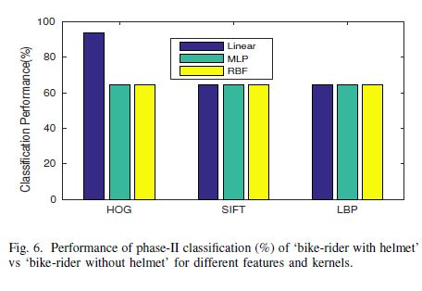
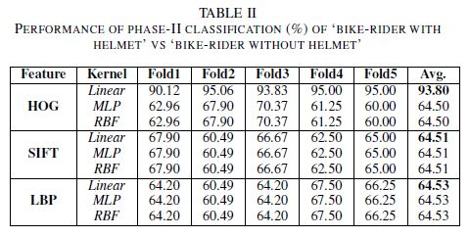
Phase-II
Table II presents results for detection of bike-rider with or without helmet using different features viz. HOG, SIFT, LBP and kernels viz. linear, MLP, RBF.
From Table II we can observe that average performance of classification using SIFT and LBP is almost similar.
The performance of classification using HOG with MLP and RBF kernel is similar to the performance of SIFT and LBP.
HOG with linear kernel performs better than all other combinations.

Slide 12
CONCLUSION
Experimental results demonstrate the accuracy of 98.88% and 93.80% for detection of bike-rider and detection of violators, respectively.
Average time taken to process a frame is 11.58 ms, which is suitable for real time use.
This framework can be extended to detect and report number plates of violators.

Slide 13
THANK YOU

